Slide 1
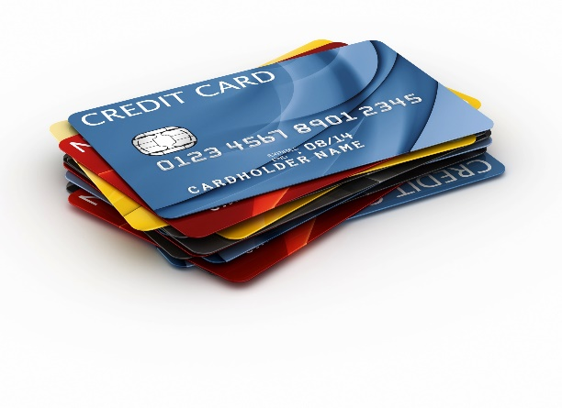
8 Types of Unsecured Business Loans and Cards that Every Business Owner Should Know About

Slide 2
Secured and Unsecured Financing
In the business lending arena there are two main types of financing
Secured financing… this includes money that requires some type of asset be pledged as collateral for the loan
Unsecured financing… this includes money that doesn’t require any collateral for approval

Slide 3
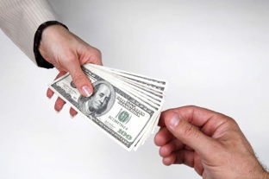
Unsecured Financing
Unsecured financing is financing that is not secured by any kind of collateral… meaning it is money that’s “unsecured”
Nothing is pledged as collateral for the debt
If the borrower defaults, the lender can pursue the borrower legally and their assets
But they don’t have a right to just take certain assets just due to the default

Slide 4
Per the Bureau of Labor and Statistics…
1 out of 5 business fail within their first year of operation
Within 5 years nearly 50% will have closed their doors
In 15 years, 75% of businesses will have closed down… for good
Most businesses do fail… making the business lending space VERY risky

Slide 5
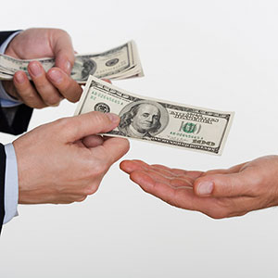
Unsecured Financing
With secured financing, the lender would just take back the asset that was pledged as collateral
This helps them quickly get back part of their loss
Since the risk isn’t as high with secured financing, borrowers can often get really good interest rates… as low as 2-5%

Slide 6
Unsecured Financing
Unsecured financing is the most risky type of business lending because if the borrower defaults the only way the lender can get back their loss is to pursue legal action
Legal action can be very costly, and not something any lender wants to pursue
This is part of why unsecured financing is so high risk, and why some of the rates you’ll see will be much higher than with secured financing

Slide 7
Types of Unsecured Financing

Slide 8
Unsecured Business Credit Cards
Most banks offer unsecured business credit cards
Most of them do report to the consumer credit reporting agencies
They all require a personal guarantee from you
You can get approved usually for one card max as they stop approving you when you have 2 or more inquiries on your report

Slide 9
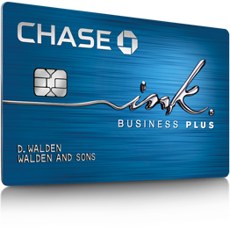
Unsecured Business Credit Cards
Chase Ink Plus… Get 50,000 points ($625) when you spend $5,000 in your first 90 days
No annual fee your first year
15-24% APR
19.24% cash advance
https://creditcards.chase.com/ink-business-credit-cards

Slide 10
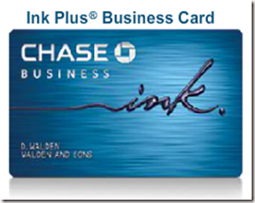
Unsecured Business Credit Cards
Chase Ink Cash Business Card
5 points for every $1 you spend on office supplies
2 points for every $1 you spend on gas and dining
1 point per $1 everywhere else
13.24% APR, 24.99% cash advance APR
https://creditcards.chase.com/ink-business-credit-cards/ink-cash-card

Slide 11
Unsecured Business Credit Cards
Capital One Spark Miles for Business, Spark Cash Select for Business, or Spark Miles Select for Business
1.5-2 miles per dollar spent
12.9-20.9% APR, 24.9% APR for cash advances
http://www.capitalone.com/credit-cards/business/spark-miles/

Slide 12
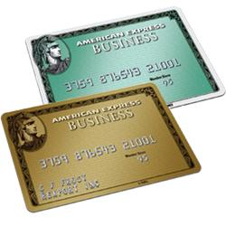
Unsecured Business Credit Cards
American Express Simply Cash Business Card, The Enhanced Gold Rewards Card, the Blue for Business Card
1-3 points per $1 spent
11.24-19.24% APR, 23% APR for cash advances
http://www.offers.com/americanexpress/simplycash/offer

Slide 13
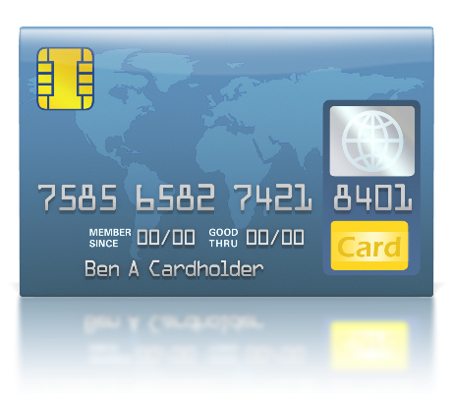
Unsecured Business Financing
Typically, when you apply for a credit card you put an inquiry on your consumer report
When other lenders see these, they won’t approve you for more credit because they don’t know how much other new credit you have recently obtained
So they’ll only approve you if you have less than 2 inquiries on your report within the last 6 months… and more will get you declined

Slide 14
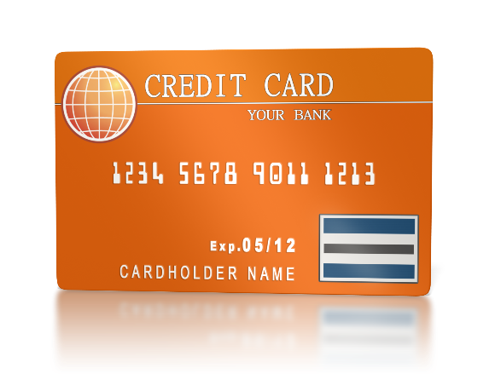
Unsecured Business Financing
With UBF, you work with a lender who specializes in securing business credit cards
This is a VERY rare, very little know about program that few lending sources offer

Slide 15
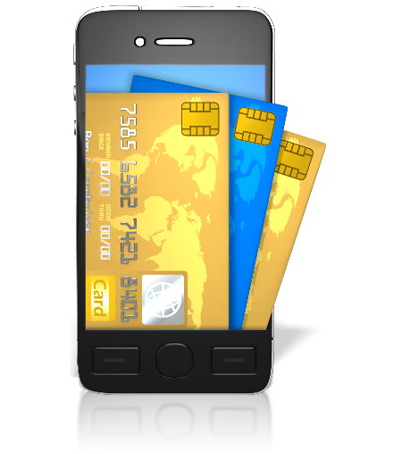
Unsecured Business Financing
They can usually get you 3-5 times the approvals that you can get on your own
This is because they know the sources to apply for, the order to apply, and can time their applications so the card issuers won’t decline you for the other card inquiries

Slide 16
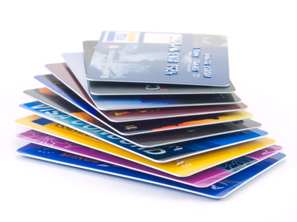
Unsecured Business Financing
The result of their services is that you usually get up to 5 cards that mimic the credit limits of your highest limit accounts now
Multiple cards create competition, and this means you can get your limits raised typically within 6 months or less of your initial approval

Slide 17
Unsecured Business Financing
With UBF they actually get you 3-5 business credit cards that report only to the business credit reporting agencies
This is HUGE, something most lenders don’t offer or advertise
Not only will you get money, but you build your business credit also
So within 3-4 months, you can then use your newly established business credit to get even more money

Slide 18
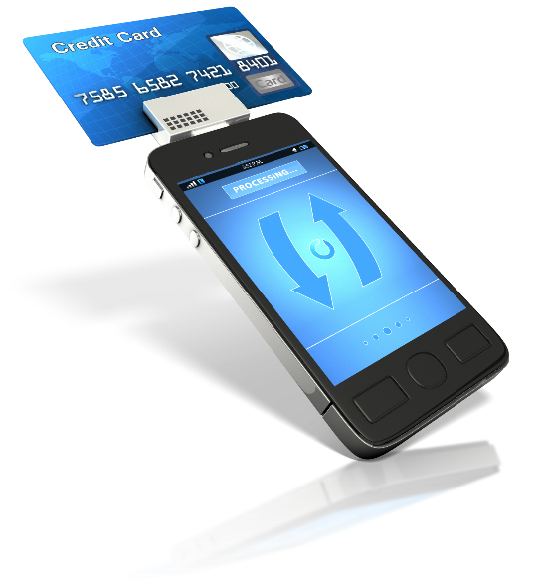
Unsecured Business Financing
The lender can also get you low intro rates, typically 0% for 6-18 months
You’ll then pay normal rates after that, typically 5-21% APR with 20-25% APR for cash advances
And they’ll also get you the best cards for points, meaning you get the best rewards

Slide 19
Unsecured Business Financing
Just like with anything, there are HUGE benefits in working with a source who specializes in this area… the results will be much better than if you try to go at it alone

Slide 20
Unsecured Business Financing
Approval limits will mimic that of your personal cards now
Approvals usually range from $2,000-50,000
You’ll usually get 3-5 cards, so that means you can get up to 5 times that of your highest credit limit accounts now
Approvals can go up to $150,000 per entity such as a corporation

Slide 21
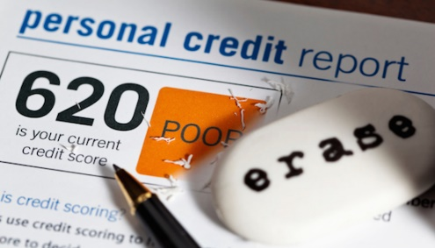
Unsecured Business Financing
You must have excellent personal credit now, preferably 700 + scores… the same as with all business credit cards
You shouldn’t have ANY derogatory credit reported to get approved
You must also have open revolving credit on your consumer reports now
You’ll need to have 2 inquiries or less in the last 6 months reported

Slide 22
Unsecured Business Financing
All lenders in this space charge a 9-12% success based fee
You only pay the fee off of what you secure
Remember, you get a ton of extra benefits and about 3-5 times more money with this program than you’d get on your own… which is why there’s a fee… the same as all other lending programs

Slide 23
Unsecured Business Financing
You can get approved using a guarantor
You can even use multiple guarantors to get even more money

Slide 24
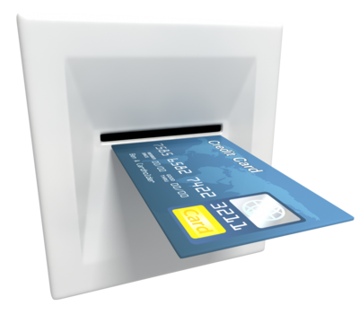
Unsecured Business Financing… Consumer Reporting
There are also other cards you can get using this same program
But these cards only report to the CONSUMER reporting agencies… not the business reporting agencies
They are consumer credit cards versus business credit cards

Slide 25
Unsecured Business Financing… Consumer Reporting
They provide similar benefits including 0% intro APRs and 5 times the amount of approval of a single card
But they’re much easier to qualify for
You can get approved with a 680 score and 5 inquiries in the last 6 months
You can have a BK on your credit… and other derogatory items
These are much easier to get approved for than UBF business cards

Slide 26
Unsecured Credit Cards… Using Business Credit
With all previous cards mentioned, you need to have good CONSUMER credit to get approved
But what if your personal credit isn’t good, and you don’t have a guarantor?
This is when BUILDING BUSINESS CREDIT makes a ton of sense
Even if you have good personal credit, building your business credit helps you get even more money… and without a personal guarantee

Slide 27
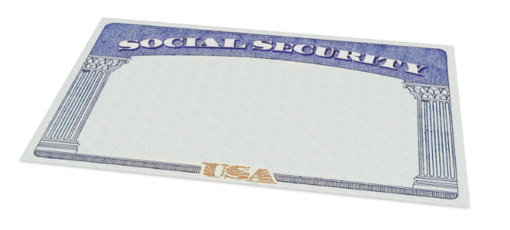
Unsecured Credit Cards… Using Business Credit
Business credit is credit in a business name, that’s linked to the business’s EIN number… now the owner’s SSN
When done properly, business credit can be obtained with no personal credit check and no personal guarantee… something all other cards mentioned can’t deliver

Slide 28
Unsecured Vendor Accounts
Most consumer credit starts with secured credit cards or an account that has a well-established co-signer
But co-signed accounts and secured accounts really aren’t popular or widely used in the business world
Most business credit starts with VENDOR accounts instead

Slide 29
Vendor Credit Accounts
VENDOR accounts are accounts that typically offer terms such as Net 30, instead of revolving
So if you get approved for $1,000 in vendor credit and use all $1,000 of it, you’d need to pay that money back in a set term… such as within 30 days on a Net 30 account

Slide 30
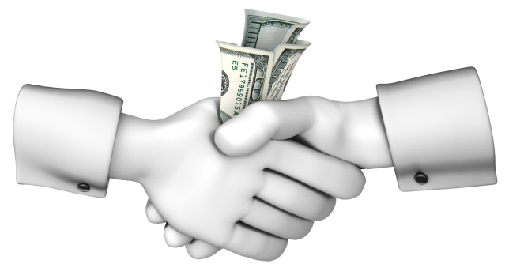
Vendor Credit Accounts
A Net 30 account would need to be paid in full within 30 days
In contrast, a Net 60 account would need to be paid in full within 60 days
Unlike with revolving accounts, you have a set time you must pay back what you borrowed or the credit you used

Slide 31
Vendor Credit Accounts
So to start your business credit profile the RIGHT way, you need to get approved for vendor accounts that report to the business credit reporting agencies
Once you’ve done this, you can then use the credit, pay back what you used, and the account gets reported to Dun & Bradstreet, Experian, or Equifax
Once reported, then you have trade lines, an established credit profile, and an established credit score

Slide 32
Vendor Credit Accounts
Using your newly established business credit profile and score, you can then get approved for cash credit, and eventually store credit… without needing to supply your SSN or personal guarantee
This is possible because now your EIN credit profile is established, and can stand on its own
So if you leave your SSN off of the application, the credit issuer then pulls your EIN credit, sees a solid profile and score, and can then approve you for real revolving credit

Slide 33
Getting Initial Business Credit
You’ll need 5 payment experiences to start getting approved for revolving store credit cards using your EIN only for approval
These are credit cards at places like Best Buy, Lowes, Staples, Amazon, Dell, Apple, Walmart, and so on
You’ll then need a total of 10 payment experiences to get approved for cash credit such as Visa and MasterCard type credit
And to get that cash credit you’ll also need to have one of those payment experiences have a $10,000 limit or higher, at least to start getting nice limits on the cash credit you secure

Slide 34
STARTER Vendor Accounts
You must start a business credit profile and score with starter vendors
Starter vendors are ones who will give you initial credit even if you have no credit, no score, or no trade lines now
Most stores like Staples will NOT give you initial starter credit, so DON’T even try applying

Slide 35
True STARTER Vendors
Laughlin Associates
Deal with corporate setup and compliance
Report to Experian
Only 411 listing and EIN required
Reports in 30-60 days
Net 30 Terms

Slide 36
True STARTER Vendors
Quill Office Supplies
Office, packaging, and cleaning supplies
Report to D&B
Must place initial order first unless D&B score is established
Usually they’ll put you on a 90 day prepayment schedule
If you order items each month for 3 months, they typically approve you for a Net 30 Account

Slide 37
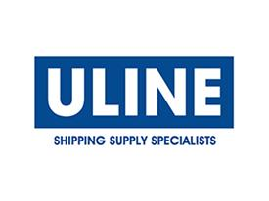
True STARTER Vendors
Uline Shipping Supplies
Shipping, packing, and industrial supplies
Report to D&B
You must have your DUNS number
They will ask for 2 references and bank reference
First few orders might need to be pre-paid to initially get approved for Net 30 terms

Slide 38
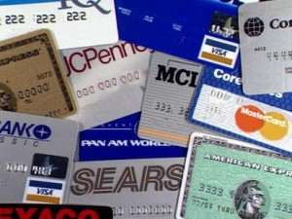
Unsecured Store Business Credit
Once you have 5 payment experiences reported, you can then secure STORE credit cards
These are cards offered by most retail stores such as Office Depot, Staples, Lowes, Home Depot, Walmart, BP, Chevron, Sam’s Club, Costco, Best Buy, Amazon, and more

Slide 39
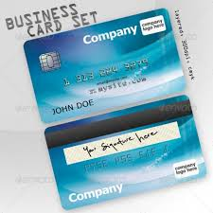
Unsecured Store Business Credit
These types of business credit store cards usually have limits of 10-100 times that of consumer credit
They function the same as consumer cards, but they don’t report to the consumer reporting agencies
They do report to the business bureaus, helping you further establish business credit

Slide 40
Unsecured Store Business Credit
You can get approved with no personal guarantee in most cases
And with initial business credit established, you can get approved leaving your SSN off of the application
This means you won’t be supplying a personal credit check for approval

Slide 41
Unsecured CASH Business Credit
Once you have 10 payment experiences reported, then you can start getting cash business credit cards
These are cards with Visa, MasterCard, and American Express that you can use anywhere, not just in specific stores
These work similar to UBF cards, but there is no personal credit check or guarantee required for approval

Slide 42
High Limit Credit Lines
Some conventional banks and private lenders also offer high-limit credit lines
You might see limits of $50,000-250,000
These are the types of accounts that I see MOST business owners truly want

Slide 43
High Limit Credit Lines
Approvals require good personal credit
And you must have good business tax returns for 2-3 years showing increasing profits
The NET revenue on your tax returns will be equivalent to the amount you can get approved for
Some sources will require collateral, but most don’t
You will need to supply a personal guarantee for approval

Slide 44
High Limit Credit Lines
Credit Lines and Credit Cards function almost the exact same
One big difference is that credit cards offer reward points and intro rates of 0%, credit lines typically don’t
But you can use credit lines to get cash advances at much lower rates than with credit cards

Slide 45
High Limit Credit Lines
Also credit lines are single accounts with a higher limit, where as credit cards usually have lower limits… but you can get more cards
Having a higher limit and low rates for cash advance are the main benefits
But this is more of a FULL DOC program, where as other cards we’ve mentioned are more NO DOC

Slide 46
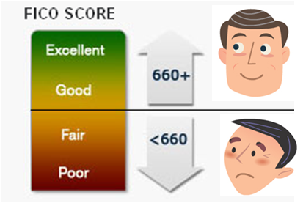
Unsecured Cash Advances
Cash advances also known as merchant advances, revenue lending, and cash flow financing, are a great way to get fast and easy money
You can get approved if you have been in business for one year or more, even if your FICO is as low as 500
This is about the ONLY type of unsecured financing that doesn’t require good personal or business credit for approval

Slide 47
Unsecured Cash Advances
Lenders will look at your most recent 6 months of bank statements to determine your approval
You should have revenue of $120,000 or more annually… and have 10 or more deposits monthly
You should manage your bank account responsibly.. having a balance left over each month and few NSF charges

Slide 48
Unsecured Cash Advances
If you meet this criteria, you can usually be approved and get money in 72 hours
Terms are usually 3-6 months initially
You can then refinance when half your loan is paid down… and get 6-18 months
Rates are high, REALLY high, as this is the highest risk money you’ll find… and also the easiest to qualify for… usually you’ll pay 15-45% and money is paid daily

Slide 49
Contact Us Today to Learn More About… 8 Types of Unsecured Business Loans and Cards that Every Business Owner Should Know About

Slide 50
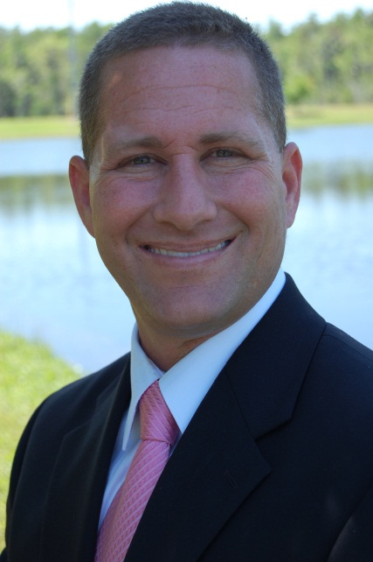
Ty Crandall 877-600-2487 info@creditsuite.com
Grab Your Free Business Credit Building Guide…
Text EIN to (855) 982-1820

